Slide 1
Marshall University Public Relations Campaign Club
2018 RMH Campaign

Slide 2
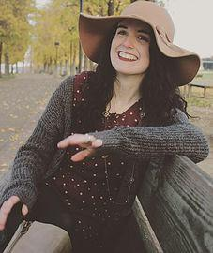
Meet the Team: Ginny Blake-Director
-Designed campaign website, portfolio, and social media posts
-Regularly updated website
-Produced Campaign video
-Organized and advertised for Chipotle event
-Organized meeting times and division of tasks
-Served as main point of contact for the House
-Spoke with Barboursville Rotary Club with Jaye
-Organized Reverse Raffle
-Gathered auction items for RR and V Club Event
*snagged the Firefly Music Festival tickets to auction off at V Club event
-Booked venue with help of Jaye
-Booked Holy Smoke BBQ
-Booked West Virginia Photo Booth
-Published social media countdown posts
-Updated spreadsheet with auction items, ticket sales, and sponsorships
-Kept track of finances
-Designed and made centerpieces for Reverse Raffle
-Packaged Auction Item Bundles
-Served as MC during event
-Organized decorations for Reverse Raffle

Slide 3
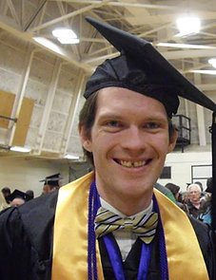
Meet the Team: James Hoyle-Assistant Director
Contributions:
Acquired several donation items for the Reverse Raffle, including several books from Empire Books.
Assisted Patrick O’Leary in getting funding from St. Joseph’s Catholic Church.
Made several calls for sponsorships.
Created posters for certain events.
Wrote several pieces to try and get people to volunteer.
Created an opinion piece, which was published in The Herald-Dispatch.
Provided emotional support when things got stressful.
Did much of the heavy lifting at the actual reverse raffle.

Slide 4
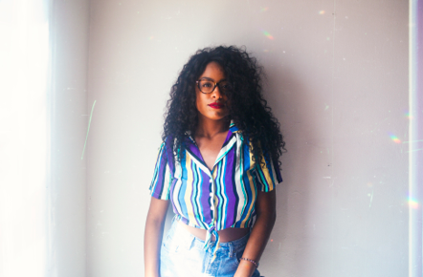
Meet the Team: Lillie Bodie-Social Media/Promotions
Contributions:
Created Social Media Plan
Created and Coordinated V Club benefit Concert, that raised $1900
  Founds bands, created schedule w/ Don Duncan, got fee of venue waived, got auction items
Booked band City Heat for Reverse Raffle, got discount to $1200
Got Liquor License for Reverse Raffle Event
· Got alcohol for the Reverse Raffle Fundraiser
· Got Bartender for Reverse Raffle Event
· Created comedy night to fundraise for Ronald McDonald House of Huntington - contacted local comedians, made schedule w/ Ian Nolte
· Got Liquor License for Reverse Raffle Event
· Got alcohol for the Reverse Raffle Fundraiser
· Got Bartender for Reverse Raffle Event
· Created comedy night to fundraise for Ronald McDonald House of Huntington - contacted local comedians, made schedule w/ Ian Nolte
· Categorized auction item baskets for Reverse Raffle
· Created Donations Letter
· Created Event Graphics
· Decorated the Reverse Raffle Event, made DIY decorations
· Got posters made at Brand Yourself - put them up around Huntington
Gained Sponsorships, including a $1,000 from Marshall Reynolds and Auction Items for Reverse Raffle
· Sent PSA’s to the Planet 92.7, at Kindred Communications,
· Sent V Club Press Release to Dave Lavender - Herald Dispatch and WSAZ

Slide 5
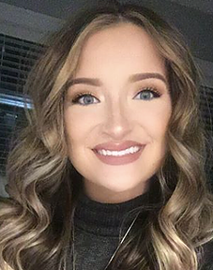
Meet the Team: Rachel Riddle-Business Relations
I collected sponsorship money from businesses like Wells Fargo, Ketchum & Greene, and Jackson Kelly.
I collected numerous auction items from all over the Tri-State as well as the Hurricane and Charleston area.
Promoted each event making numerous social media posts dedicated to the mission.
I helped in the planning of each event. I worked on organizing and decorating each event: doing things like organizing auction items, writing bid sheets, setting up tables, chairs and decorations, buying and shopping for décor for the event. I also manned the auction tables at each event making sure guests questions were answered accurately.

Slide 6
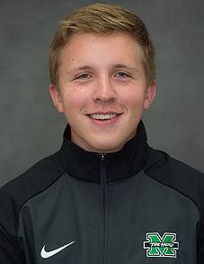
Meet the Team: Patrick O’Leary-Media Relations
Major Contributions:
-Spoke to three mass services at St. Joseph’s and following these services accepted donations of any kind and looked to sell tickets. Was able to raise over $1,500 from three masses.
-Had an op-ed published in the Charleston Gazette-Mail
-Sent out press releases for three of our major events, and was able to receive placement in the Huntington Herald-Dispatch for the V Club fundraiser and the Reverse Raffle fundraiser.
-Press release for Reverse Raffle helped land WCHS-TV to cover the event
-Came in contact with on-air personalities of TCR Country who said they would spread the word of our fundraiser.
-Earned a $150 sponsorship from the Union Bar and Grill.
-Earned silent auction item of autographed basketball from every member of the Marshall men’s basketball team and head coach Dan D’Antoni. Other major items included packages from Cincinnati Reds, Cincinnati Reds Hall of Fame, and West Virginia Power.
-Secured 80 chairs and five tables from Marshall Catholic Newman Center which were necessary to be used for Reverse Raffle.
-Took care of dance floor rental process with A-Z Rentals including ordering floor and organizing setup/breakdown time.

Slide 7
Meet The House / Research
Situation: The Ronald McDonald house needs both funding and a younger audience base. Most of their donors are middle-aged/retired. It has been found that once Millennials find a charity to donate to they stick with it, unlike the generation before them. As for funding, the Ronald McDonald
house needs about $650,000 a year. 35% comes from McDonalds, but they cannot count on that fully.
Goal: to raise money and awareness for the Ronald McDonald House. Original goal of 20,000 dollars.
Objective:
- Educate people as to what Ronald McDonald House is
- Raise funds for the house
- Discover areas to expand from last year’s campaign
Audience:
- Community members
*Fresh out of college – young parents
~People who are able to give, but may not be aware of how
*Marshall Alumni
- Marshall Students
*Typically low on funds
*Very busy
*Many different backgrounds and stories
*Not a lot of knowledge of the Ronald McDonald House
- Previous and current donors

Slide 8
ACTION
In order to make profit for the Ronald McDonald House, a wide array of fundraisers were utilized in order to make money.
While the Reverse Raffle brought in the most money of any event, several other fundraisers were used
Major Fundraisers that brought in profit (excluding Reverse Raffle ticket sales/auction item sales)
-Chipotle Fundraiser
-V Club Fundraiser
-Black Sheep Comedy Fundraiser
-Talking to St. Joseph Speech
Often, these events put group members out of their comfort zone by requiring members to ask people for monetary donations

Slide 9
REVERSE RAFFLE EVENT PLAN
What: The participants are offered the opportunity buy raffle tickets, and when their number is drawn they are disqualified. Halfway through the event the losing ticket holders may buy back into the raffle. The last ticket remaining wins the auctioned item. All proceeds will go towards to Ronald McDonald House for the Tri-State budget.
Setting: Black Sheep Harley Davidson Clubhouse
Date: April 28, 2018
Time:
- Raffle begins at 7 p.m.
- Silent Auction ends at 10:30
- Event ends by 11 p.m.
Ticket Prices: $50 per person
Raffle ticket prices:
- Buy in starting at $10 and gradually increases throughout the night
Attire: Cocktail
Food: Catering from Holy Smoke BBQ
Extras:
- Photo booth
- Silent auction
- City Heat for live entertainment

Slide 10
REVERSE RAFFLE SCHEDULE
10:00 AM Meet at Harley Davidson to begin set up.
10 – 3 PM Set up and organize
3:30 – 5:30 PM Leave and get ready for event
5:45 PM Be back at HD
6:45 PM Everyone at their stations
7:00 PM Doors open and event begins
7:45 PM Jaye and Ginny open. Jaye introduces House, Ginny introduce evening and explains Pom-Pom game. Lillie explains buyback process for Reverse Raffle Buy Back.
8:00 PM CITY HEAT BEGINS PLAYING
James pulls first 35 numbers.
8:35 PM James pulls 36-70
8:00 PM PHOTO BOOTH OPENS
James pulls 71-105
Beginning of Pom-Pom game
8:20 PM James pulls 106-120
9:15 PM James pulls 120-130
BUY BACK ENDS
9:30 PM James pulls 131-140
Ginny sells golden ticket and then pulls to final three
10:00 PM WINNER ANNOUNCED
10:15 PM PHOTO BOOTH CLOSES
10:30 PM SILENT AUCTION ENDS
Team comes to stage to end the evening
Ginny thanks everyone
11:00 PM Begin teardown

Slide 11
COMMUNICATION
Several actions were utilized to raise funds and awareness for the Ronald McDonald House:
As far as events were concerned, press releases were used to get awareness to the media.
Press releases were sent out prior to the Chipotle fundraiser, V Club fundraiser, and Reverse Raffle fundraiser
V Club and Reverse Raffle fundraiser press releases were placed in Huntington Herald-Dispatch
Other newspaper placements included two op-ed pieces: one by Patrick O’Leary for Charleston Gazette-Mail and one by James Hoyle for Huntington Herald-Dispatch
Two radio stations were contacted about spreading information about various fundraisers and agreed to: The Planet and TCR Country
WCHS-TV covered the Reverse Raffle fundraiser, and learned about the event through a press release
Social media reached a wide audience, as well as word of mouth about the various events

Slide 12
EVALUATION
We will be using SWOT to analyze our campaign efforts.

Slide 13
SWOT
Strengths:
· We had a great team of students that worked diligently to make sure this campaign was a success. We utilized our connections.
· Last years portfolio gave us strong connections with businesses in the Tri State that were willing to support our cause again, as well as a list of do’s and dont’s that were extremely helpful when navigating the campaign.
· Our professor, Dr. Hapney, and the Director of Development at the Ronald McDonald House, Jaye Toler, were extremely helpful in assisting and guiding our group when needed.
· Our group had a lot of personal connections throughout the local business world that allowed us to raise funds and auction items for the cause.

Slide 14
SWOT
Weaknesses:
· Our group was small. Last semesters group had 17 students and this semester we had 5. This alone cut down on the networking opportunities available because there is only so much that 5 people can do.
· It was our first time. Because it was our first time it took us a little while to get our footing and get into the swing of things. I think if we had more time we could’ve raised more money for the house but it was a great learning experience.
· We had trouble with businesses not getting back to us in a timely manner or not getting back to us at all. This made getting sponsorships difficult.

Slide 15
SWOT
Opportunities:
· Getting involved with other events to become potential fundraisers
· Theme was very trendy – set food and music
· Utilize social media on personal accounts for – donations and sponsors
We had many opportunities taking this creative approach with the reverse raffle. Our theme allowed us to match food and music, and give our fundraiser a trendy vibe. Also other events around the area, gave us the opportunity to become involved and a method to fundraise money for the Ronald McDonald House, such as Black Sheep’s comedy night.

Slide 16
SWOT
Threats:
· Other fundraising events occurring within that weekend – Autism Walk, Color Run, HMOA , Marshall’s Spring Game
o Ticket sales
o Sponsors
o Donations
A threat of having the Reverse Raffle was all the other fundraisers going on, for good causes. For example, there was the Autism Walk the day before and the Color Run the morning of the event. Another threat was big events asking for donations, this lessened the chance of us getting anything donated from the same business, and lowered the quantity of our sponsorships.

Slide 17
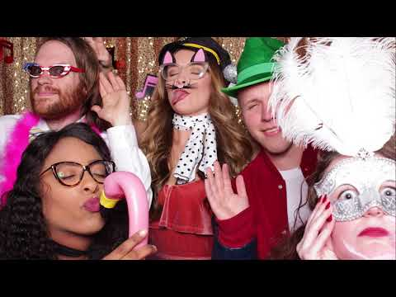
2018 RMH CAPSTONE CAMPAIGN

